Slide 1
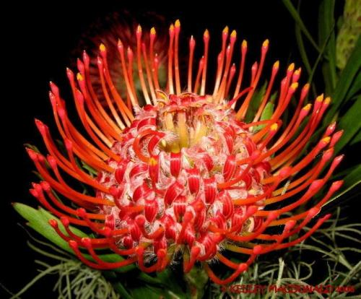

“Javascript team Project”
TEAM "PINCUSHION FLOWER ANNUAL"

Slide 2
Team Members
Slav Slavchev
Username: Slav.Slavchev
Rostislav Dimitrov
Username: BoniMislyashki
Asen Gonov
Username: micro3x
Alexandar Ivanov
Username: alexxokey
Alexandar Iliev
Username: aleksiliev
Georgi Cvetanov
Username: Jorkata06

Slide 3
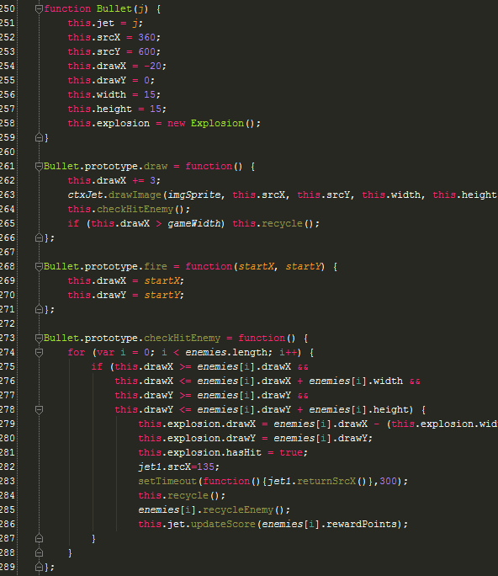
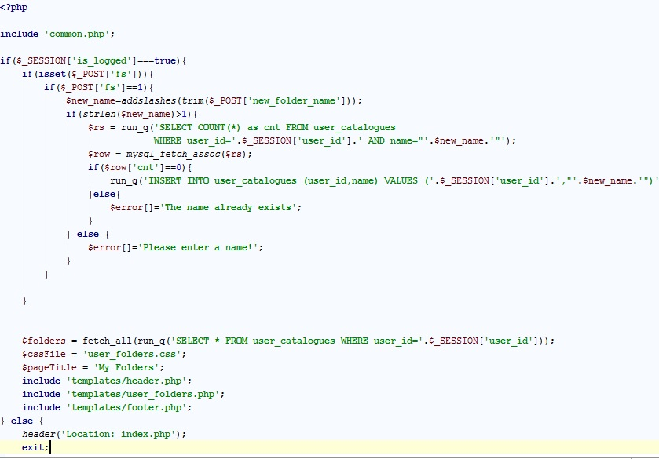
Brief code description

Slide 4


